Slide 1
Vector Addition

Slide 2
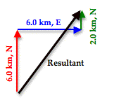
Head-to-tail method

Slide 3
Resultant
The resultant is the overall vector

Slide 4
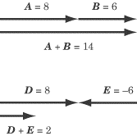
Parallel Vector Addition

Slide 5
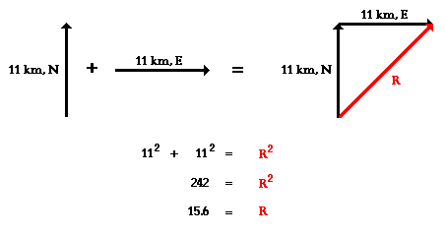
Perpendicular Vector Addition

