Slide 1
Acceleration in One-Dimension

Slide 2
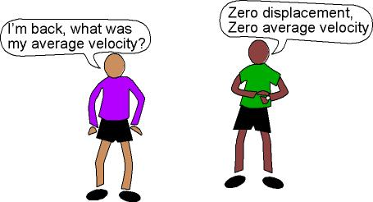
Average Velocity
Average means a number typical of the whole set of data
Takes into account the displacement and time
$v_{avg} or v$

Slide 3
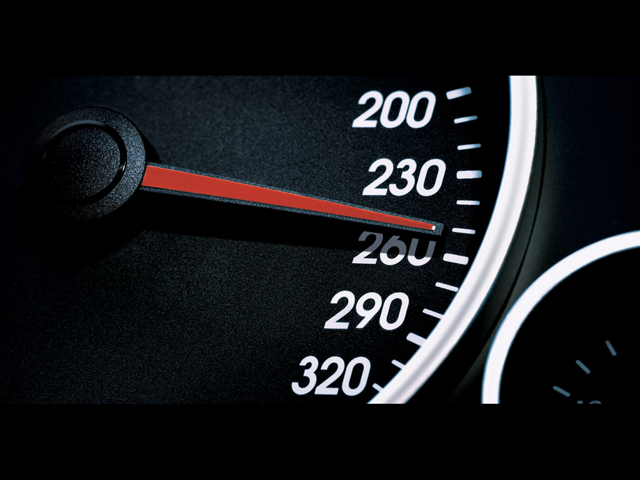
Instantaneous Velocity
VS
Instantaneous velocity refers to the exact speed in a given moment
$v_{i} or v_{f}$

Slide 4
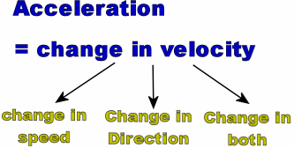
Acceleration
Acceleration is a vector quantity that is defined as the rate at which an object changes its velocity.
An object is accelerating if it is changing its velocity.
Measured in meters per second per second (m/s²)

Slide 5
Misuse of the term acceleration
Sports announcers will occasionally say that a person is accelerating if he/she is moving fast. Yet acceleration has nothing to do with going fast.
A person can be moving very fast and still not be accelerating.
Acceleration has to do with changing how fast an object is moving.
If an object is not changing its velocity, then the object is not accelerating.

Slide 6
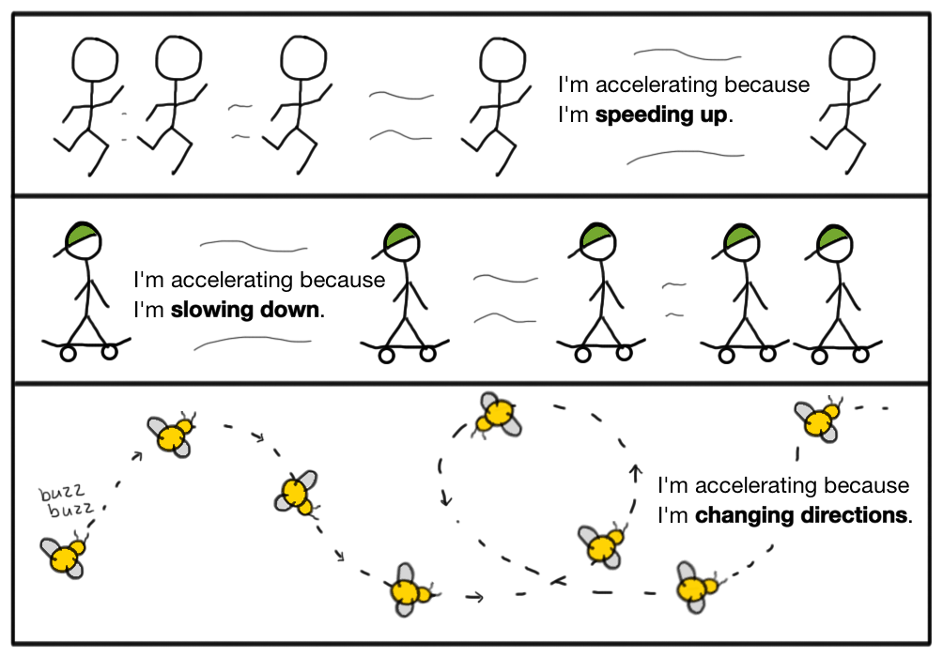

Slide 7
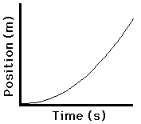
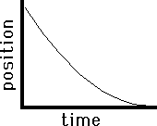
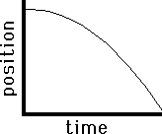
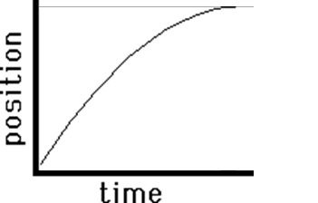
Acceleration on p-t graphs
Speeding up (slope is increasing)
Slowing down (slope is decreasing)

Slide 8
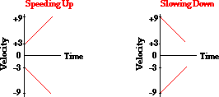
Acceleration on v-t graphs
Velocity is increasing AWAY from zero
Velocity is decreasing TOWARDS zero

Slide 9
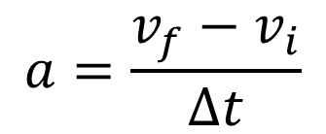
Acceleration Equations
$$a=\frac{v_{f}−v_{i}}{∆t}$$
$v_{f}=v_{i}+a(∆t$)
$$∆d=v_{i}∆t+1/2a{(∆t)}^{2}$$
$${v_{f}}^{2}={v_{i}}^{2}+2a(∆d)$$
Note, $∆d$ and $∆t$ are used to indicate displacement and time respectively in these equations. The $∆$represents a change in, and in these problems we often consider a specific time and distance interval.
The equations may also be written correctly without the $∆.$

