Slide 1
Gravity Free-Falling Objects

Slide 2
What is free-fall?
An object is considered to be in free-fall whenever there is nothing acting on it EXCEPT gravity.
We ignore AIR resistance and pretend everything happens in a vacuum. (Even though we know it doesn’t)

Slide 3
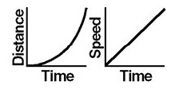
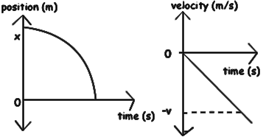
Motion Graphs of an object in Free-Fall

Slide 4
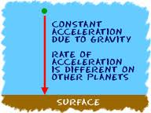
Acceleration Due to Gravity
On our glorious home planet of earth, the fancy scientists have defined the acceleration due to gravity to be precisely… 9.80665 m/s²!
We will just use 9.8 m/s²
We physicists call this constant g.

Slide 5
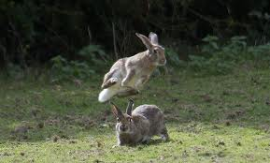
Direction of vertical acceleration
Rule of thumb! If an object is slowing down, then its acceleration is in the opposite direction of its motion.
Is gravity slowing the bunny down or helping him speed up as he jumps up? Slowing him down! That means acceleration needs to be opposite the direction he’s moving. He’s moving up (+) so a = - 9.8 m/s²

Slide 6
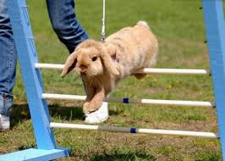
What about this bunny? He’s on his way down.
Is the acceleration due to gravity speeding him up or slowing him down?
Speeding him up! That means acceleration is in the direction of his motion. He’s moving down (-), so a = - 9.8 m/s²

Slide 7
Hold up, wait a minute… they are both negative?
YES!
If gravity was only negative for you…

Slide 8
Help me! My gravity is broken!

Slide 9
Yay. ☺
But its not. Gravity works for everyone.

Slide 10
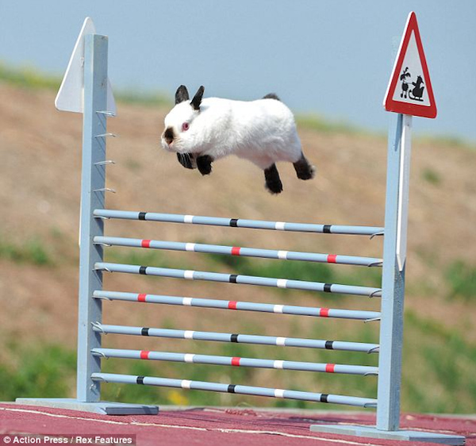
Velocity During Vertical Motion
From our time on planet earth, we know that when things are thrown upwards, shot upwards, jump up… they must come back down.
We refer to the top of this path of travel as the apex.
What is the vertical velocity at the apex?
v = 0 m/s

Slide 11
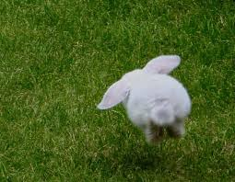
If a bunny jumps straight upwards at 1 m/s, what is the velocity as it returns to the ground?
v_{up} = v_{i} = 1 m/s (positive because he’s moving upwards)
v_{down} = v_{f} = -1 m/s (negative because he’s moving downwards)
Only the direction of the velocity changes, the magnitude remains the same.

Slide 12
Hidden Variables for Free-Fall Problems
These variables may not be spelled out. You need to read the problem carefully and remember for these.
These are only true for VERTICAL problems, not horizontal problems.
a =-g= -9.8 m/s² ON EARTH ONLY
v_{apex} = 0 m/s (this could be considered v_{f} if you want to know max height)
v_{i} = 0 m/s when dropped
v_{up} = -v_{down} (this is useful for time in the air problems)
When falling, vertical displacement is NEGATIVE

