Slide 1
Torque

Slide 2
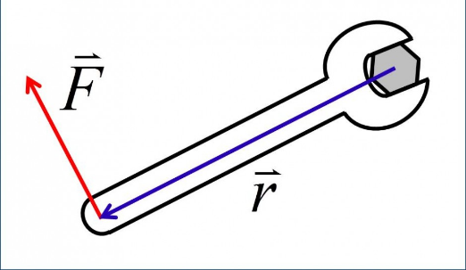
Torque
Torque is the tendency of a force to cause a the rotation of an object around an axis
We though of force as a push or pull
We can think of torque as a twist

Slide 3
Torque
Torques influence the rotation of an object
$$Torque=Force∙lever arm$$
$$τ=F∙r$$
Symbol: $τ$ (tau)
Unit: N · m (Newton-meter)

Slide 4
Torque
What is the torque applied to a bolt when a force of 20 Newtons is used with a 0.3 m wrench?

Slide 5
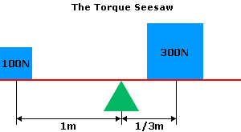
Rotational Equilibrium
Equilibrium is when all forces are balanced
Rotational equilibrium is when torques are balanced

Slide 6
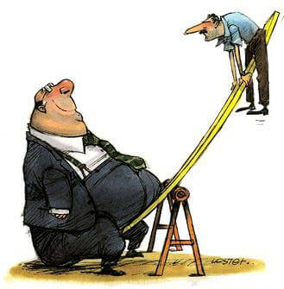
Rotational Equilibrium
When one end has a much greater torque, the see saw is not in equilibrium.
What should the larger man do to put the see saw in equilibrium?

