Slide 1
Warm-Up
Explain why a mover carrying a box is not doing any work by the physics definition of work.

Slide 2
Work vs. Power
Work has nothing to do with the amount of time that this force acts to cause the displacement.
Sometimes, the work is done very quickly and other times the work is done rather slowly.
So how do we differentiate between work done slowly and work done quickly?

Slide 3
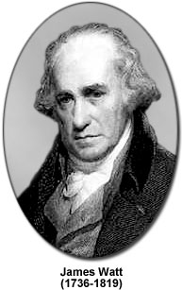
Power
We use the quantity of power to describe how quickly work can be performed.
The unit of Power is the Watt.
1 Watt = 1 Joule
1 second
1 W = 1 J/s
W
P
t

Slide 4
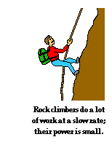
For example, a rock climber takes an abnormally long time to elevate her body up a few meters along the side of a cliff. On the other hand, a trail hiker (who selects the easier path up the mountain) might elevate her body a few meters in a short amount of time. The two people might do the same amount of work, yet the hiker does the work in considerably less time than the rock climber. The hiker has more power than the rock climber because she does the same amount of work faster.

Slide 5
Write about it
In 2-3 sentences, write about how two people could do the same amount of work but have different amounts of power.
In 2-3 sentences, write about how two people could do different amounts of work, but have the same power.

Slide 6
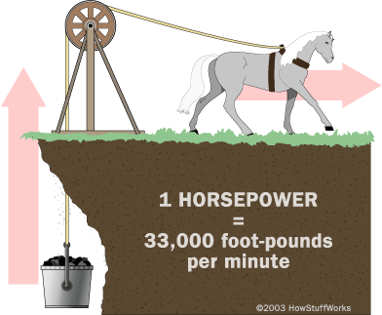
Other units of power
Historically and today, another unit of power is common.
Horsepower
Where did this weird unit come from?
1 hp = 746 W

Slide 7
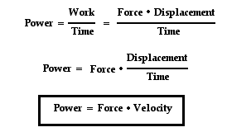
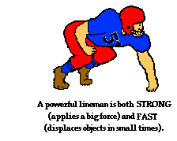
Some formula magic
You don’t need to know this formula, but it’s pretty cool!

Slide 8
Two physics students, Will N. Andable and Ben Pumpiniron, are in the weightlifting room. Will lifts the 100-pound barbell over his head 10 times in one minute; Ben lifts the 100-pound barbell over his head 10 times in 10 seconds.
Which student does the most work?
Which student delivers the most power?

Slide 9
Power Example #1
A mechanic uses a jack to lift a truck and does 7258 J of work. If he lifts the truck in 30 seconds, what was the power output?
W = 7258 J
t = 30 s
P = W/t
P = (7258 J)/(30 s)
P = 242 J/s = 242 W

Slide 10
Power Example #2
If a 60 W light bulb does 216,000 J of work, how long has it been burning?
P = 60 W
W = 216,000 J
P = W/t
t = W/P
t = (216,000 J)/(60 W)
t = 3600 s

Slide 11
Personal Power Lab
You need to collect the following data:
The height of each stair on the staircase YOU went up
The number of stairs on the staircase YOU went up. (he landing counts as one step)
The time it took YOU to climb the stairs.

Slide 12
Class Data
Student | Time (s) | Work Done (J) | Power (W)

