Slide 1
Systems of Objects (Forces 2)
Notes:
1

Slide 2
Sample problem
A 5.0 kg object (m₁) is connected to a 10.0 kg object (m₂) by a string. If a pulling force F of 20 N is applied to the 5.0 kg object as shown,
A) what is the acceleration of the system?
B) what is the tension in the string connecting the objects?
(Assume a frictionless surface.)
Copyright James Walker, “Physics”, 1st ed.
Notes:
2

Slide 3
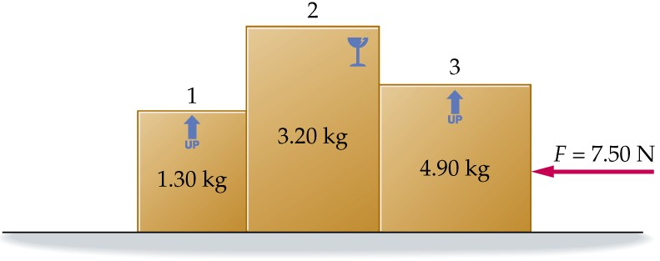
Sample Problem
A force of magnitude 7.50 N pushes three boxes with masses m₁ = 1.30 kg, m₂ = 3.20 kg, and m₃ = 4.90 kg as shown. Find the contact force between (a) boxes 1 and 2 and (b) between boxes 2 and 3.
Copyright James Walker, “Physics”, 1st edition
Notes:
3

Slide 4
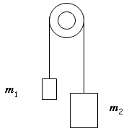
An Atwood’s machine has m1 = 1kg, m2 = 2kg, hung from an ideal pulley. What is the acceleration of the masses? Calculate the tension in the string attached to each mass.

