Slide 1
Motion in 2-Dimensions

Slide 2
2-Dimensional Motion
So far we’ve covered motion in 1 dimension.
An object moves up and down
An object moves left to right
Motion in 2 dimensions is often referred to as projectile motion
An object thrown or launched and moves under the influence of gravity only

Slide 3
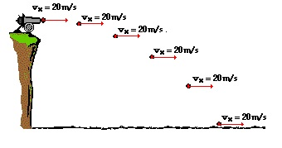
Horizontal Motion
The horizontal motion of a projectile does not change over the course of the projectiles path
There is no horizontal acceleration
a_{x} = 0 m/s²
Horizontal velocity is constant
$v_{x}=v_{ix}=v_{fx}$
$x=v_{x}∙t$

Slide 4
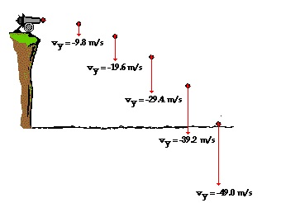

Vertical Motion
The vertical motion is influenced by gravity.
a_{y} = -9.8 m/s²
Vertical velocity changes by 9.8 m/s every second
$y=v_{iy}∙t+\frac{1}{2}a_{y}t^{2}$

Slide 5
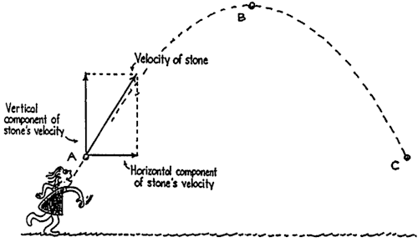
Components of velocity
How much velocity is horizontal and how much is vertical is determined by the angle of launch

Slide 6
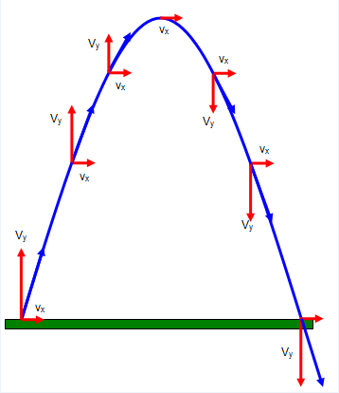
For our class, we will not calculate vector components.
You should however know the following
Angles less than 45° result in more horizontal velocity
Angles greater than 45° result in more vertical velocity
Angles equal to 45 ° result in equal horizontal and vertical velocities.

Slide 7
Solving 2-D Problems
For this class, projectiles will always be launched from a height(y) and have no vertical velocity (v_{iy} = 0 m/s)

Slide 8
Outline this for each problem
Horizontal Components | Vertical Components
x = ? | y = - ?
v_{ix} v_{x}= ? v_{fx} | v_{iy} = 0 m/s v_{fy} = ?
a_{x} = 0 m/s² | a_{y} = -9.8 m/s²
t = ?
Vertical displacement is NEGATIVE
Horizontal velocity is CONSTANT, means acceleration is zero!
v_{iy} is always 0. If the problem does not give, or ask for v_{fy}, cross it out
Provided its on earth!
Time is common to both.

Slide 9
To start with a horizontal or vertical equation?
Pick the component side that only has ONE unknown.
Solve for that unknown.
Fill it in. Can you solve for the other side now?
Solve for the other component’s unknown variable.

