Slide 1
Rotational motion
Centripetal Acceleration and Force

Slide 2
What is Rotational Motion?
Rotational motion is a kind of motion where something moves around a central point
This point is often called the fulcrum.

Slide 3
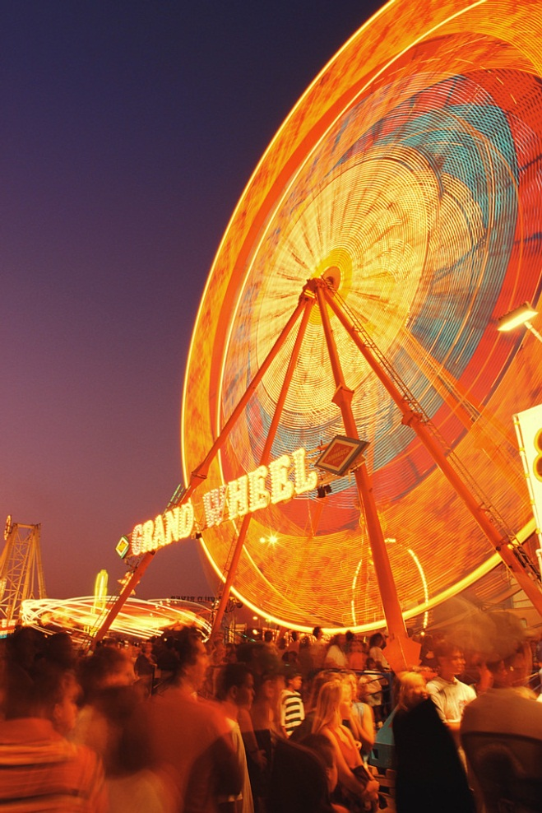
What is Rotational Motion?
As the object moves, it rotates about a central point
This is called the axis of rotation
Is it easy to measure how far an object has traveled in a circular path?

Slide 4
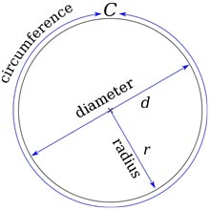
The distance of a circular path
How do you measure how far around a circle something goes?
Circumference of a circle
C = 2πr

Slide 5
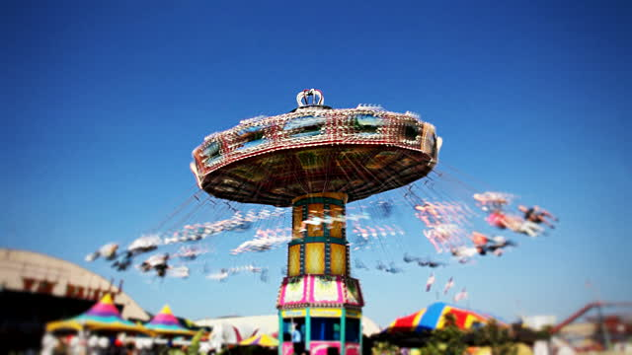
Linear Velocity of Rotating Objects
Linear Velocity
This is the velocity of a rotating object at any point along the rotating path.
linear velocity is also known as the Tangential Velocity

Slide 6
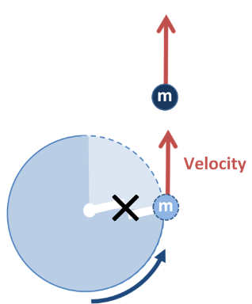
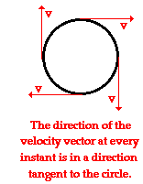
Linear Velocity of Rotating Objects
Think of tangential velocity as the velocity of an object on a string and the string broke.
What would the motion and velocity of that that object be?

Slide 7
What does this look like?
Tangential Velocity
v_{T}
r

Slide 8
Tangential Velocity
Tangential Velocity:
The formula for tangential velocity is:
$v_{t}=\frac{d}{t}$
Note the distance in this case is usually the circumference of the circle
The time is usually the time it takes to make one rotation

Slide 9
Example
Example:
The radius of a CD in a computer is 0.0600 m. If a microbe riding on the disc’s rim completes 1 rotation in 0.20 seconds, what is his tangential velocity?

Slide 10
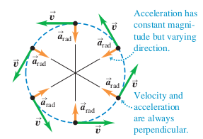
Centripetal Acceleration
Centripetal means center seeking
Centripetal Acceleration:
Any acceleration which is caused when an object is traveling at a constant speed but changing direction by moving in a circular path is known as Centripetal Acceleration
$a_{c}=\frac{{v_{t}}^{2}}{r}$

Slide 11
Centripetal Acceleration
Centripetal Acceleration:
v_{t}
a_{c}

Slide 12
The relationship
If r increases, what happens to a_{c}?
If r decreases, what happens to a_{c}?
If v_{t} increases, what happens to a_{c}?
If v_{t} decreases, what happens to a_{c}?

Slide 13
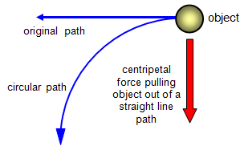
Centripetal Force
The force that causes centripetal acceleration
The force an object experiences toward the center of the circular path.
$F_{c}=m∙a_{c}$

Slide 14
Centripetal Force
Centripetal Force:
v
F_{c}

Slide 15
Example
Example:
A 25 kilogram child rides a Ferris wheel with a radius of 75 meters. He completes one rotation every 180 seconds. What is the magnitude of the centripetal force?

