Slide 1
Classroom Expectations
Please bring your notebook everyday
Yes, you will still need a composition notebook for this class. Keep your agendas in the NB and any other assignments that are not in the course book.
Yes, some assignments in the course book will be graded for a daily grade.
Yes, the course book must be completed in order to receive the 5 % BONUS at the end of the six weeks.

Slide 2
Classroom Expectations
Cell Phone use and other electronic devices
Put them away unless otherwise told so
I don’t care if you are done with todays work, you may not pull out your phone. Bring a book or work on something for another class.
No, you may not charge your cell phone in my classroom. If I see a phone out that is charging, it will be confiscated.

Slide 3
Classroom Expectations
Teacher website:
http://marieisokpunwu.weebly.com/
Teacher remind:
Text @cebhd8 to 81010
Teacher email:
Marie_Isokpunwu@roundrockisd.org

Slide 4
Classroom Expectations
Grading:
20% Daily
40% Minor (Quizzes, Labs, etc.)
40% Major (Tests, Projects, Labs, etc.)

Slide 5
Classroom Expectations
Course books and/ or notebooks will be collected the day of the test for grading
Should you fail a test, you are welcome to attend tutorials for re-teaching and re-testing. The maximum score for a re-test is 70%
All re-tests must take place within one week of the original test being returned

Slide 6
Tutorials
When are tutorials?
Tuesday PM and Friday AM
The physics teachers have broken up the responsibility of hosting tutorials, please check the schedule in the window by the door

Slide 7
Assessment Dates For the Unit
Practice Quiz 1: Work and Power Content Quiz
1/12 (B)
Practice Quiz 2: Energy Content Quiz
1/23 (B)
WEP Quiz
1/25 (B)
Test: Work, Power and Energy
1/31 (B)
Project: TBA next week
2/11 (B)

Slide 8
KC #1
What was your favorite part of physics last semester?
What is one thing you were not great at in physics last semester that you are going to work to be better at this semester?

Slide 9
Work and Power

Slide 10
Quantity Chart: Work & Power
Quantity | Variable in Formula | Unit | Unit Symbol
Work | W | Newton-Meters or Joules | N·m J
Force | F | Newtons | N
Displacement | d | Meters | m
Power | P | Watts | W
Time | t | Seconds | s

Slide 11
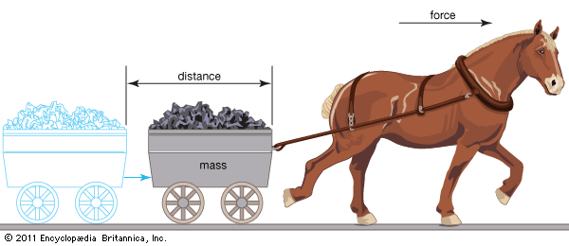
What is work?
Work occurs when force causes a displacement
In order to be considered work, it must be the force that causes the displacement.
If a force is present, but it does not cause the displacement (or no displacement is caused), it is not work!

Slide 12
Work or Not work?
A teacher applies a force to a wall and becomes exhausted.
This is not an example of work. The wall is not displaced.
A book falls off a table and free falls to the ground.
Yes! There is a force (gravity) which acts on the book which causes it to be displaced in a downward direction (i.e., "fall").
Force
Displacement
Force

Slide 13
A waiter carries a tray full of meals above his head by one arm straight across the room at constant speed.
This is not an example of work. There is a force (the waiter pushes up on the tray) and there is a displacement (the tray is moved horizontally across the room). To cause a displacement, the force must be in the same direction.
not in the same direction
Force
Displacement

Slide 14
A rocket accelerates through space.
This is an example of work. There is a force (the expelled gases push on the rocket) which causes the rocket to be displaced through space.
Force
Displacement

Slide 15
Work or Not?
Are the following situations examples of work? Why or why not?
An excited teacher hits the desk.
A mover carries a box down the hall.
A swimmer swims to the other end of the pool and back.
A dog pulls a sled.

Slide 16
Work
Work = Force x Displacement
W = F•∆d

Slide 17
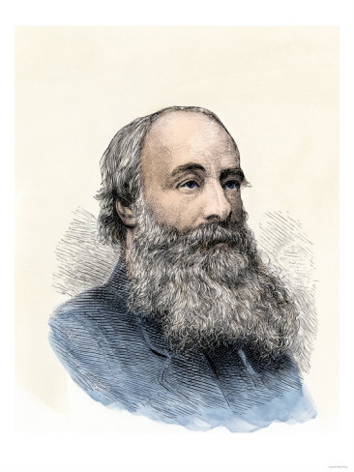
The unit of work
The Joule is the unit of work.
1 Joule = 1 Newton • 1 meter
1 J = 1 N • m
James Prescott Joule
His work led to the law of conservation of energy.

Slide 18
Example #1
How much work is done by a person who uses a force of 27.5 N to move a grocery cart 12.3 m?
F = 27.5 N
∆d = 12.3 m
W = F•∆d
W = (27.5 N)(12.3 m)
W = 338.3 N•m
W = 338.3 J

Slide 19
Example #2
55, 000 J of work is done to move a rock 25 m. How much force was applied?
W = 55,000 J
∆d = 25 m
F = ?
W = F•∆d
55,000 J = F•(25 m)
F = 55,000 J / 25 m
F = 2200 N

