Slide 1
Warm-Up
Based on this weeks lessons and the lab, answer the following questions.
What are two ways to increase potential energy?
What are two ways to increase kinetic energy?
How does adding friction change the types of energy in a system?

Slide 2
Work Energy Theorem

Slide 3
Conservation of Energy
The law of conservation of energy states that energy cannot be created nor destroyed.
Energy must be CONSERVED.
Energy goes from one form to another.

Slide 4
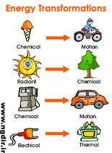
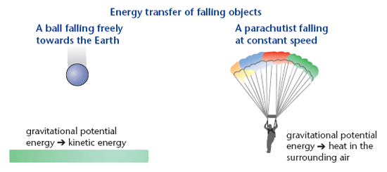
Energy Transformations
Energy changes form, but not amount.

Slide 5
Work Energy Theorem
The work-energy theorem states that the work done to an object (or by an object) equals the change in mechanical energy.
This means that energy can be put in, or taken out of a system.
A system consists of all objects we are taking in to consideration.

Slide 6
Mechanical Energy
If a World Civilization book is lifted to the top shelf of a student locker, then the student supplies the force to do the work on the book. If a plow is displaced across a field, then some form of farm equipment (usually a tractor or a horse) supplies the force to do the work on the plow. If a pitcher winds up and accelerates a baseball towards home plate, then the pitcher supplies the force to do the work on the baseball. If a roller coaster car is displaced from ground level to the top of the first drop of a roller coaster ride, then a chain driven by a motor supplies the force to do the work on the car. If a barbell is displaced from ground level to a height above a weightlifter's head, then the weightlifter is supplying a force to do work on the barbell. In all instances, an object that possesses some form of energy supplies the force to do the work. In the instances described here, the objects doing the work (a student, a tractor, a pitcher, a motor/chain) possess chemical potential energy stored in food or fuel that is transformed into work. In the process of doing work, the object that is doing the work exchanges energy with the object upon which the work is done. When the work is done upon the object, that object gains energy. The energy acquired by the objects upon which work is done is known as mechanical energy.

Slide 7
Work with Kinetic Energy
Let’s say a hockey puck starts at rest on the ice. How much energy does it have?
Now, a player is going to do work to the puck. Let’s pretend he does 100 J of work.
How much kinetic energy does the puck now have?

Slide 8

$$W=∆KE \\ W={KE}_{f}−{KE}_{i} \\ W=1/2mv_{f}^{2}−1/2mv_{i}^{2}$$

Slide 9
Work and Potential Energy
Gravity is a conservative force and can do work too.
Therefore, if you lift something up, you are doing work against gravity and you have changed that object’s potential energy.

Slide 10

$W=∆{PE}_{g}$ $W={PE}_{f}−{PE}_{i}$ $W=mgh_{f}−mgh_{i}$

Slide 11
I know this may seem a bit overwhelming at the moment, but I promise it will get easier.
For now, please understand the following two things:
Work done TO a system ADDS energy to the system.
Work done BY a system SUBTRACTS energy from the system.

Slide 12
Conservation of Energy Videos
Desert Meteor
Race Car Crash
Ok Go-This Too Shall Pass
Fireworks
Gymnast
How to leave the office
Springs
Bear

Slide 13
Introducing Energy Diagrams
All of this one kind of energy changing to another type means that there are many possible combinations of equations.
We are going to use energy diagrams to help us develop our equation for this type of problem.

Slide 14
The LoL Chart
The System
Final Position
Initial Position
We are going to write down or draw what the system is!
We also will show energy leaving or entering the system by work!
This is energy we have at the start!
This is energy we have at the end!

